Slide 1

Hospitality Analysis
Hospitality Analysis

Slide 2


Hospitality Data
DIM_HOTELS & ROOMS
FACT_BOOKINGS
Hotels Data: Contains 25 properties categorized by type and city location,.
Rooms Data: Defines 4 room categories with classifications like Standard, Elite, Premium, and Presidential.
FACT_AGGREGATED_BOOKINGS
fact bookings table contains detailed transactional data about individual bookings. It includes information such as booking ID, customer ID, booking date, amount, and status (confirmed, canceled, etc.)
DIM_DATE
This dataset serves as a date dimension table, featuring 92 entries categorized by specific dates, months, and week numbers
It includes metrics like total bookings, revenue, and cancellations aggregated by dimensions such as date, location, or customer segment.

Slide 3
Key Performance Indicators
Total Revenue
1708.77 millions
Total Revenue refers to the total income generated by a hospitality business from all of its operational activities over a specific period
Total Revenue provides a comprehensive view of the financial performance of the hospitality business
Total Bookings
134.59 k
Total Bookings in hospitality refers to the total number of reservations or bookings made by guests within a specific period. This metric is crucial for assessing demand, planning resources, and forecasting revenue. It includes all types of bookings, whether confirmed, pending, or canceled.
Occupancy Rate
57.9%
Occupancy Rate in hospitality refers to the percentage of available rooms that are occupied over a specific period
A higher occupancy rate typically indicates good room demand, while a lower rate may suggest reduced demand.
Cancellation Rate
24.8%
Cancellation Rate in hospitality refers to the percentage of bookings that are canceled by guests before their scheduled arrival. A high cancellation rate can indicate issues with booking policies, guest confidence, or market conditions, while a low rate suggests a stable booking process.
Daily Utilize Rooms
1.03k
Daily Utilized Rooms in hospitality refers to the number of rooms that are occupied on a given day. It indicates the level of demand and how effectively a hotel is filling its available rooms. This metric is essential for understanding daily performance and adjusting operations such as staffing and pricing.

Slide 4
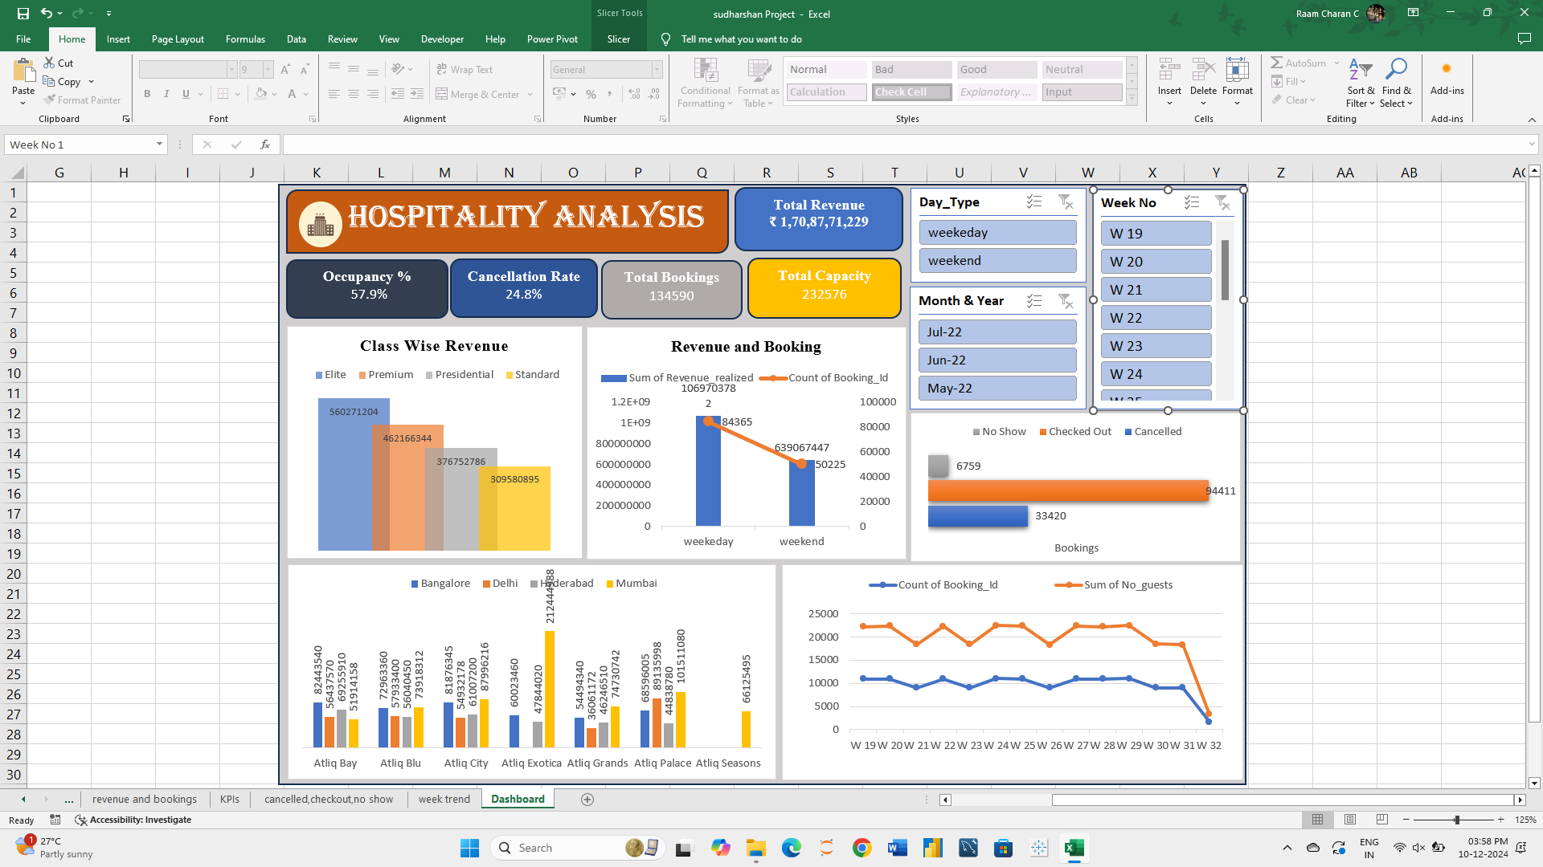
MS Excel Dashboard

Slide 5
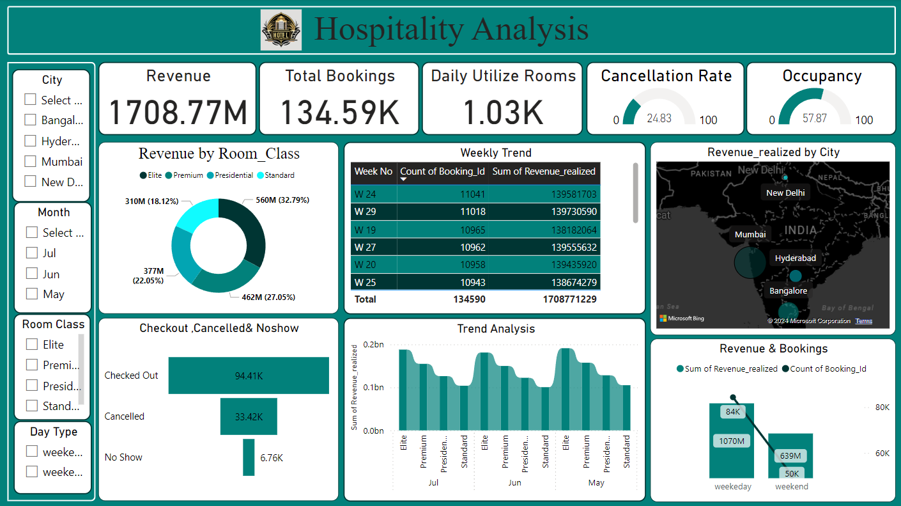
Power BI

Slide 6
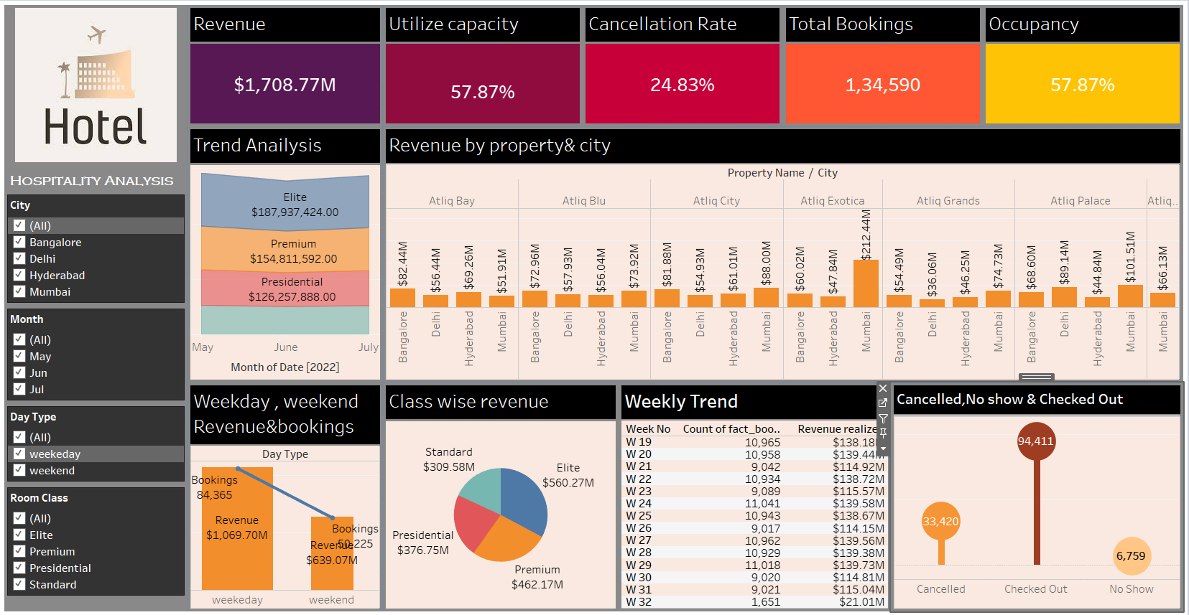
Tableau

Slide 7





Key Takeaways
Key Takeaways
Revenue Optimization
Introduce dynamic pricing to maximize revenue during low-demand periods.
Promote upselling and cross-selling of higher room categories and services.
2. Occupancy Rate Improvement
Use data-driven marketing campaigns to attract guests in low-demand periods
Expand loyalty programs for repeat customers
3. Cancellation Rate Reduction
Implement flexible booking policies
Provide incentives for non-cancellable bookings and prepayments.
4. Addressing No-Shows
Require partial prepayments to reduce cancellations.
Send automated check-in reminders to guests
5. Property Specific Strategies
Address challenges at underperforming properties with upgrades
6. Room Class Performance
Enhance amenities for standard and premium classes to boost demand
Offer personalized discounts and upgrades for loyalty members.

Slide 8


